Slide 1
Dynamic Programming:
Matrix Chain Multiplication

Slide 2
Algorithmic Paradigms
Greedy: Build up a global solution incrementally, myopically by optimizing some local criterion.
Divide-and-conquer: Break up a problem into disjoint (non-overlapping) sub-problems, solve the sub-problems recursively, and then combine their solutions to form solution to the original problem. Brand-new subproblems are generated at each step of the recursion.
Dynamic programming: Break up a problem into a series of overlapping sub-problems, and build up solutions to larger and larger sub-problems. Typically, same subproblems are generated repeatedly when a recursive algorithm is run.
Notes:
overlapping sub-problem = sub-problem whose results can be reused several times

Slide 3
Dynamic Programming History
Bellman. [1950s] Pioneered the systematic study of dynamic programming.
Etymology.
  Dynamic programming = planning over time.
  Secretary of Defense was hostile to mathematical research.
  Bellman sought an impressive name to avoid confrontation.
Reference: Bellman, R. E. Eye of the Hurricane, An Autobiography.

Slide 4
Dynamic Programming Applications
Areas.
  Bioinformatics.
  Control theory.
  Information theory.
  Operations research.
  Computer science: theory, graphics, AI, compilers, systems, ….

Slide 5
Review: Dynamic programming
DP is a method for solving certain kind of problems
DP can be applied when the solution of a problem includes solutions to subproblems
We need to find a recursive formula for the solution
We can recursively solve subproblems, starting from the trivial case, and save their solutions in memory
In the end we’ll get the solution of the whole problem

Slide 6
Properties of a Problem that can be Solved with Dynamic Programming
Simple Subproblems
  We should be able to break the original problem to smaller subproblems that have the same structure
Optimal Substructure of the Problems
  The solution to the problem must be a composition of subproblem solutions
Subproblem Overlap
  Optimal subproblems to unrelated problems can contain subproblems in common

Slide 7
Computing Fibonacci Numbers
Fibonacci numbers:
  F₀ = 0
  F₁ = 1
  F_{n} = F_{n - 1} + F_{n - 2} for n > 1
Sequence is 0, 1, 1, 2, 3, 5, 8, 13, …
Obvious recursive algorithm (Sometimes can be inefficient):
Fib(n):
  if n = 0 or 1 then
  return n
  else
  return ( Fib(n − 1) + Fib(n − 2) )

Slide 8
Recursion Tree for Fib(5)
Fib(5)
Fib(4)
Fib(3)
Fib(3)
Fib(2)
Fib(2)
Fib(1)
Fib(2)
Fib(1)
Fib(1)
Fib(0)
Fib(1)
Fib(0)
Fib(1)
Fib(0)

Slide 9
How Many Recursive Calls?
If all leaves had the same depth, then there would be about 2^{n} recursive calls.
But this is over-counting.
However with more careful counting it can be shown that it is Ω((1.6)^{n})
Still exponential!
Wasteful approach - repeat work unnecessarily
  Fib(2) is computed three times
Instead, compute Fib(2) once, store result in a table, and access it when needed

Slide 10
More Efficient Recursive Algorithm
F[0] := 0; F[1] := 1; F[n] := Fib(n);
Fib(n):
  if n = 0 or 1 then return F[n]
  if F[n − 1] = NIL then F[n − 1] := Fib(n − 1)
  if F[n − 2] = NIL then F[n − 2] := Fib(n − 2)
  return ( F[n − 1] + F[n − 2] )
computes each F[i] only once, store result in a table, and access it when needed.
called memoization

Slide 11
Example of Memoized Fib
F
0
1
2
3
4
5
returns 3+2 = 5,
fills in F[5] with 5
0
Fib(5)
1
1
returns 2+1 = 3,
fills in F[4] with 3
NIL
Fib(4)
2
NIL
3
NIL
returns 1+1 = 2,
fills in F[3] with 2
Fib(3)
5
NIL
returns 0+1 = 1,
fills in F[2] with 1
Fib(2)

Slide 12
Get Rid of the Recursion
Recursion adds overhead
  extra time for function calls
  extra space to store information on the runtime stack about each currently active function call
Avoid the recursion overhead by filling in the table entries bottom up, instead of top down.

Slide 13
Subproblem Dependencies
Figure out which subproblems rely on which other subproblems
Example:
F₀ F₁ F₂ F₃ … F_{n-2} F_{n-1} F_{n}

Slide 14
Order for Computing Subproblems
Then figure out an order for computing the subproblems that respects the dependencies:
  when you are solving a subproblem, you have already solved all the subproblems on which it depends
Example: Just solve them in the order
F₀ , F₁ , F₂ , F₃ , …
called Dynamic Programming

Slide 15
DP Solution for Fibonacci
Fib(n):
    F[0] := 0; F[1] := 1;
    for i := 2 to n do
      F[i] := F[i − 1] + F[i − 2]
    return F[n]
Can perform application-specific optimizations
  e.g., save space by only keeping last two numbers computed
time reduced from
exponential to linear!

Slide 16

Matrix Chain Multiplication Problem
Multiplying non-square matrices:
  A is p × q, B is q × r
  AB is p × r whose (i, j) entry is ∑a_{ik} b_{kj}
Computing AB takes p·q·r scalar multiplications and p(q−1)r scalar additions (using basic algorithm).
Suppose we have a sequence of matrices to multiply. What is the best order?
must be equal

Slide 17


Matrix Chain Multiplication Problem
Given a sequence of matrices A₁, A₂, …, A_{n}, then
Compute C = A₁. A₂. …, A_{n}
Different ways to compute C
Matrix multiplication is associative
  So output will be the same
However, time cost can be very different
  Example

Slide 18
Why Order Matters
Suppose we have 4 matrices:
  A, 30 × 01
  B, 01 × 40
  C, 40 × 10
  D, 10 × 25
((AB)(CD)) : requires 41,200 multiplications
  [ (30×1×40) + (40×10×25) +(30×40×25) = 41,200 ]
(A((BC)D)) : requires 1400 multiplications
[ (1×40×10) + (1×10×25) +(30×1×25) = 1,400 ]

Slide 19
Matrix Chain Multiplication Problem
Given a sequence of matrices A₁, A₂, …, A_{n}, where A_{i} is p_{i-1} × p_{i}:
  1) What is minimum number of scalar multiplications required to compute A₁· A₂ ·… · A_{n}?
  2) What order of matrix multiplications achieves this minimum?
Fully parenthesize the product in a way that minimizes the number of scalar multiplications
( ( ) ( ) ) ( ( ) ( ( ) ( ( ) ( ) ) ) )
No. of parenthesizations: ???

Slide 20
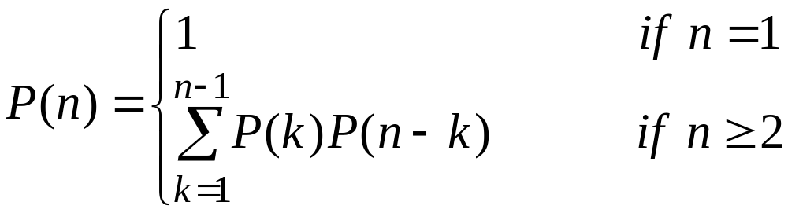
A Possible Solution
Try all possibilities and choose the best one.
Drawback is there are too many of them (exponential in the number of matrices to be multiplied)
The number of parenthesizations is
The solution to the recurrence is Ω(2^{n})
No. of parenthesizations: Exponential
Need to be more clever - try dynamic programming !

Slide 21
Step 1: Optimal Substructure Property
A problem exhibits optimal substructure if an optimal solution to the problem contains within it optimal solutions to subproblems.
Whenever a problem exhibits optimal substructure, we have a good clue that dynamic programming might apply.
Consequently, we must take care to ensure that the range of subproblems we consider includes those used in an optimal solution.
We must also take care to ensure that the total number of distinct subproblems is a polynomial in the input size.

Slide 22
Step 1: Optimal Substructure Property
Define A_{i··j} , i ≤ j, to be the matrix that results from evaluating the product A_{i}· A_{i+1} ·… · A_{j}.
If the problem is nontrivial, i.e, i < j, then to parenthesize A_{i}· A_{i+1} ·… · A_{j}, split the product between A_{k} and A_{k+1} for some k, where i ≤ k < j.
The cost of parenthesizing this way is
  The cost of computing the matrix A_{i··k} +
  The cost of computing the matrix A_{k+1··j} +
  The cost of multiplying them together
The optimal substructure of this problem is:
An optimal parenthesization of A_{i}· A_{i+1} ·… · A_{j} contains within it optimal parenthesizations of A_{i}· A_{i+1} ·… · A_{k} and A_{k+1}· A_{k+2} ·… · A_{j}
Proof ?

Slide 23
Overlapping Subproblem Property
Two subproblems of the same problem are independent if they do not share resources.
Two subproblems are overlapping if they are really the same subproblem that occurs as a subproblem of different problems.
A problem exhibits overlapping subproblem if the number of subproblems is “small” in the sense that a recursive algorithm solves the same subproblems over and over, rather than always generating new subproblems.
Dynamic programming algorithms take advantage of overlapping subproblems by solving each subproblem once and then storing the solution in a table where it can be looked up when needed.

Slide 24
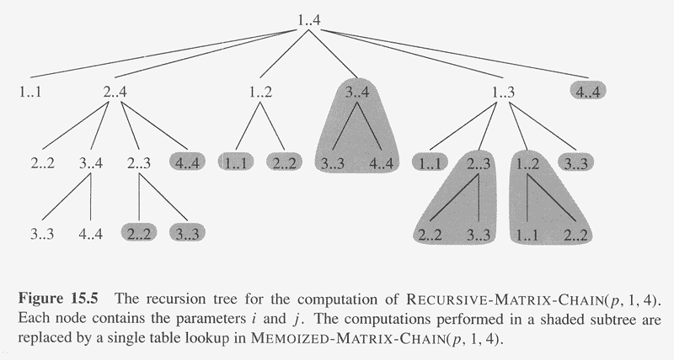
Overlapping Subproblem Property

Slide 25
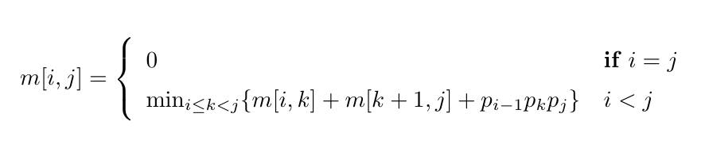
Step 2: Develop a Recursive Solution
Define m[i, j] to be the minimum number of multiplications needed to compute A_{i}· A_{i+1} ·… · A_{j} .
  Goal: Find m[1, n]
  Basis: m[i, i] = 0
  Recursion: How to define m[i, j] recursively ?
Consider all possible ways to split A_{i} through A_{j} into two pieces.
Compare the costs of all these splits:
  best case cost for computing the product of the two pieces
  plus the cost of multiplying the two products
Take the best one

Slide 26
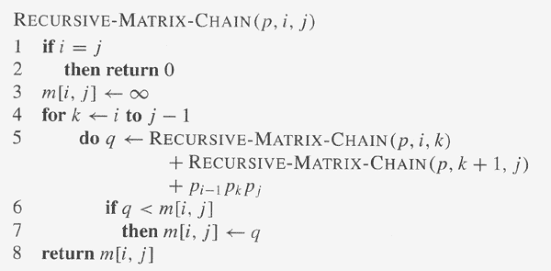
Step 2: Develop a Recursive Solution

Slide 27
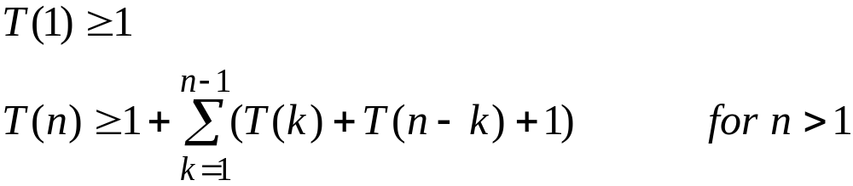
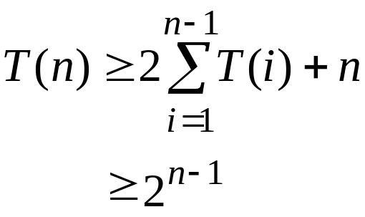
Step 2: Develop a Recursive Solution
Let T(n) be the time taken by Recursive-Matrix-Chain for n matrices.
For i = 1, 2, …, n−1, each term T(i) appears once as T(k) and once as T(n−k) . Thus, we have
Then T(n) = Ω(2^{n})

Slide 28
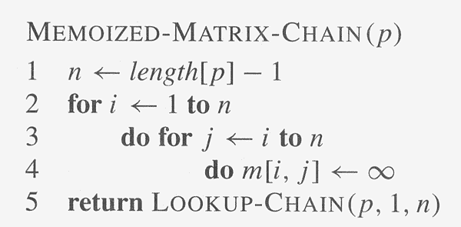
A Recursive Solution (Memoization)
A memoized recursive algorithm maintains an entry in a table for the solution to each subproblem.

Slide 29
A Recursive Solution (Memoization)
Lookup-Chain(m, p, i, j)
if m[i, j] < ∝
return m[i, j]
if i = = j
m[i, j] = 0
else for k = i to j – 1
q = Lookup-Chain(m, p, i, k) +
Lookup-Chain(m, p, k + 1, j) + p_{i-1} p_{k} p_{j}
if q < m[i, j]
m[i, j] = q
return m[i, j]
running time O(n³)

Slide 30
Step 3: Compute the Optimal Costs
Find Dependencies among Subproblems
m:
 | 1 | 2 | 3 | 4 | 5
1 | 0
2 | n/a | 0
3 | n/a | n/a | 0
4 | n/a | n/a | n/a | 0
5 | n/a | n/a | n/a | n/a | 0
GOAL !
computing the red
square requires the
blue ones: to the
left and below.

Slide 31
Step 3: Compute the Optimal Costs
Find Dependencies among Subproblems
m:
 | 1 | 2 | 3 | j | 5
1 | 0
i | n/a | 0
3 | n/a | n/a | 0
4 | n/a | n/a | n/a | 0
5 | n/a | n/a | n/a | n/a | 0
Computing m(i, j) uses
  everything in same row to the left:
  m(i, i), m(i, i+1), …, m(i, j-1)
  and everything in same column below:
  m(i+1, j), m(i+2, j), …, m(j, j)

Slide 32
Step 3: Compute the Optimal Costs
Identify Order for Solving Subproblems
Solve the subproblems (i.e., fill in the table entries) this way:
  go along the diagonal
  start just above the main diagonal
  end in the upper right corner (goal)
m:
 | 1 | 2 | 3 | 4 | 5
1 | 0
2 | n/a | 0
3 | n/a | n/a | 0
4 | n/a | n/a | n/a | 0
5 | n/a | n/a | n/a | n/a | 0

Slide 33

Step 3: Compute the Optimal Costs
Identify Order for Solving Subproblems
A1 (30 × 35)
A2 (35 × 15)
A3 (15 × 05)
A4 (05 × 10)
A5 (10 × 20)
A6 (20 × 25)

Slide 34
Step 3: Compute the Optimal Costs
Identify Order for Solving Subproblems
 | 1 | 2 | 3 | 4 | 5 | 6
1 | 0
2 |  | 0
3 |  |  | 0
4 |  |  |  | 0
5 |  |  |  |  | 0
6 |  |  |  |  |  | 0
A1 (30 × 35)
A2 (35 × 15)
A3 (15 × 05)
A4 (05 × 10)
A5 (10 × 20)
A6 (20 × 25)
15750
7875
9375
11875
15125
2625
4375
7125
10500
750
2500
5375
1000
3500
5000

Slide 35
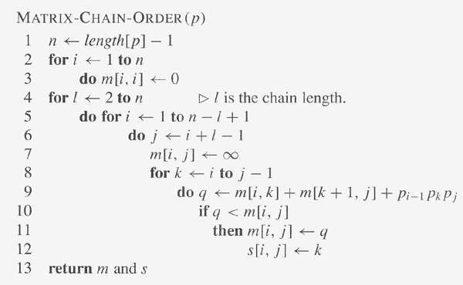
Step 3: Compute the Optimal Costs
Pseudocode
running time O(n³)

Slide 36
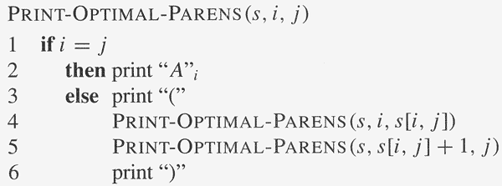
Step 4: Construct an Optimal Solution
It's fine to know the cost of the cheapest order, but what is that cheapest order?
Keep another array s and update it when computing the minimum cost in the inner loop
After m and s have been filled in, then call a recursive algorithm on s to print out the actual order

